Slide 1
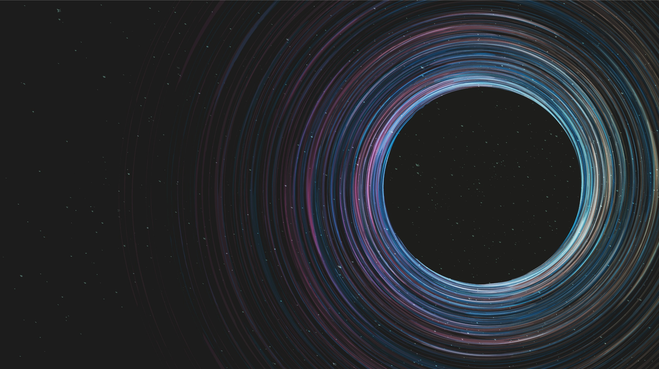
Parameter Estimation of 21cm Signal
Aryana Haghjoo

Slide 2


Outline
Motivation
Parameter Estimation
Non-Standard Physics
Future Observations
Introduction
Theoretical Model and ARES
EDGES Data
Markov Chain Monte Carlo
ARES version
RBFI version
Levenberg - Marquardt

Slide 3
Motivation and Introduction
(So you wanna see the non-standard physics? 😈)
Why is it important to estimate the parameters?
How does this estimation help us to identify the effects of non-standard physics?
How sensitive do future telescopes need to be in order to capture these effects?
Notes:
Thousands of ways to estimate params
Remember from my last talk:
Non-standard physics, like cosmic strings: have been analytically proven to enhance the amplitude of data by at least a factor of 2
When you have this code in hand, you can check to see which params are changing if you add those effects

Slide 4
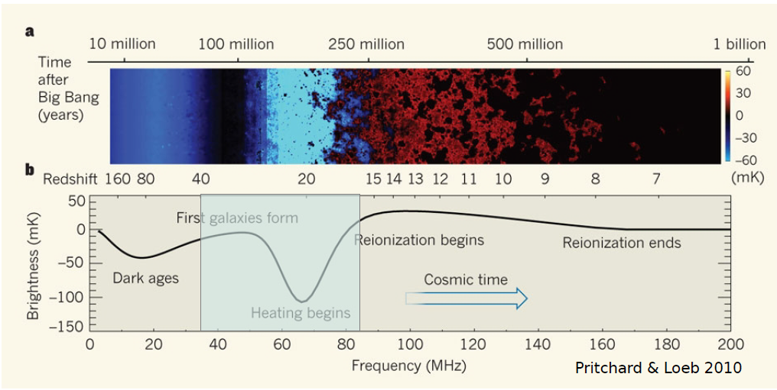
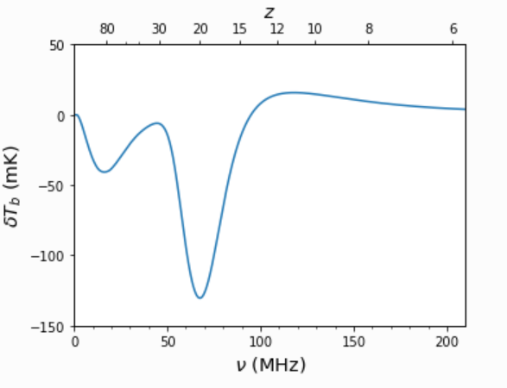
We have got a theoretical model …

Slide 5
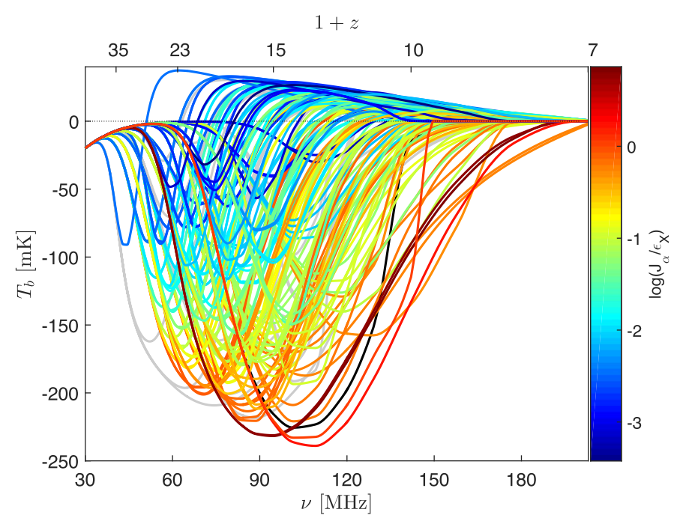
The 21-cm global signal as a function of redshift for 193 different astrophysical models

Slide 6
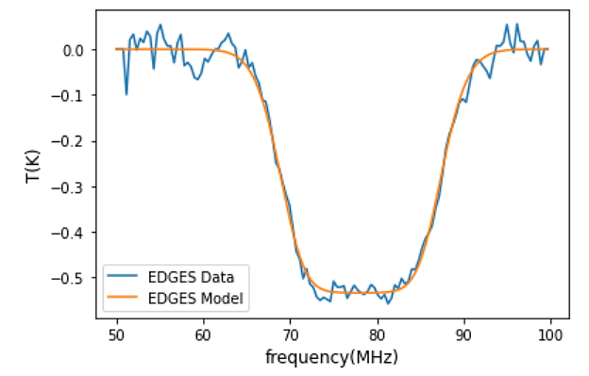
And a pretty cool data set!!!

Slide 7
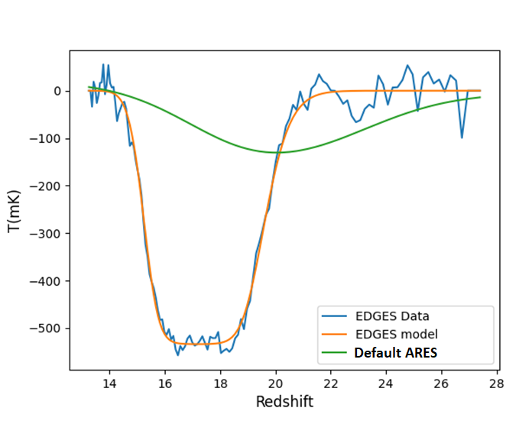
In fact, the comparison seems a bit scary!
Notes:
When I first saw this plot, I know I was screwed up!

Slide 8

Markov Chain Monte Carlo (MCMC)

Slide 9
How does it work?
9
Model (parameters)
Initial Guess of Parameters
Model (Initial Guess)
Chi-Square
Data
Notes:
Iterative process!

Slide 10
Model (Random Point)
Random Point in Phase Space
New Chi-Square
Accept it as a new point on the chain
Satisfied
New Chi-Square
<
Accept it with the probability of
exp(-0.5*(new chisq-chisq))
Chi-Square
Not Satisfied
Notes:
Draw a random point from the gaussian distribution (with the mean value set on the last point and an arbitrary deviation which will affect your acceptance ratio)

Slide 11
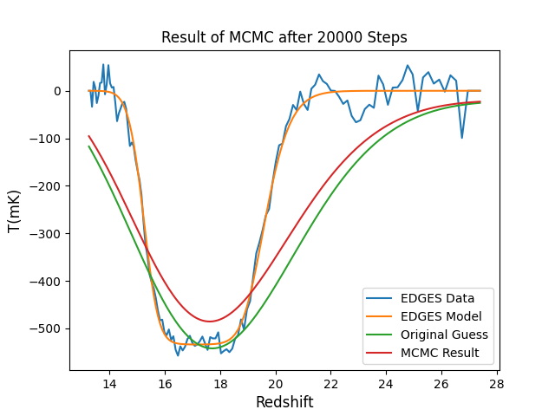
MCMC with ARES
~ 23 hours to produce this plot!
Still not yet fully converged!
I used to multiply the model with a factor to make it come closer to the data
Fitted parameters:
{'multiplication_factor': 5.02, 'fstar': 0.01, 'fX': 0.99, 'fesc': 0.74, 'clumping_factor': 0.01, 'cX': 5.72}

Slide 12
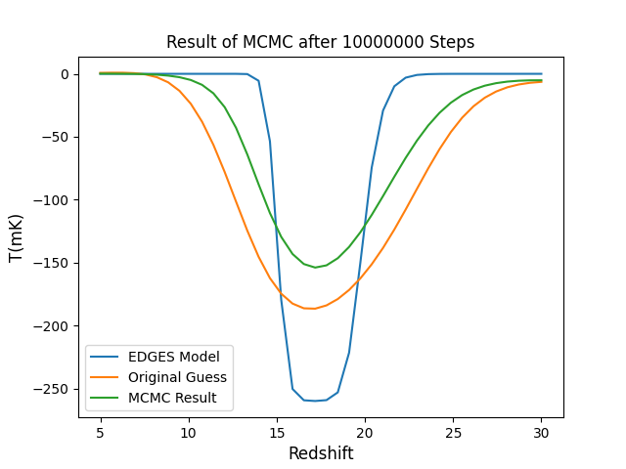
MCMC with RBFI
(Radial Basis Function Interpolation)
Runtime: ~ 22 hours
fully converged! (Proved by the power spectrum)
Multiplication factor is omitted
Half of the amplitude of the observed data
Fitted parameters:
{'pop_rad_yield_0_': 4067.48, 'pop_rad_yield_1_': 2.02e+38, 'pop_rad_yield_2_': 19908.87, 'clumping_factor': 0.85}
RBFI Credits: Hans Hopkins, Justin Cardona, Jared Tritt, Luc Bojorquez-Lopez

Slide 13
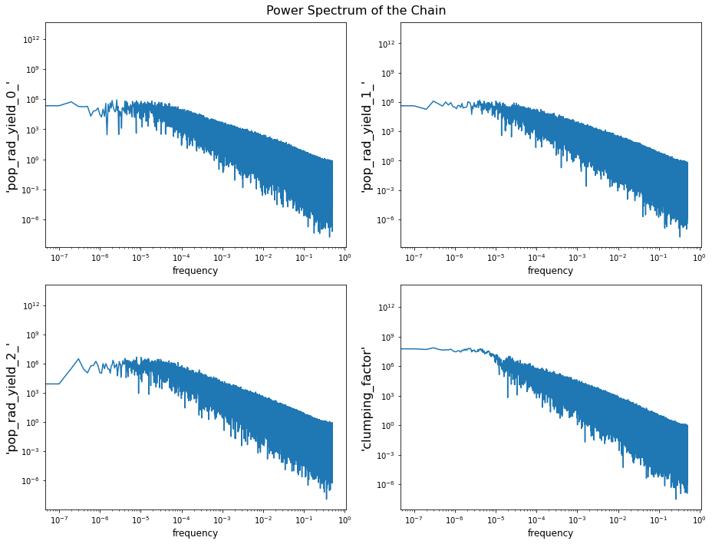
Convergence
Notes:
But we have used a lot of steps!

Slide 14
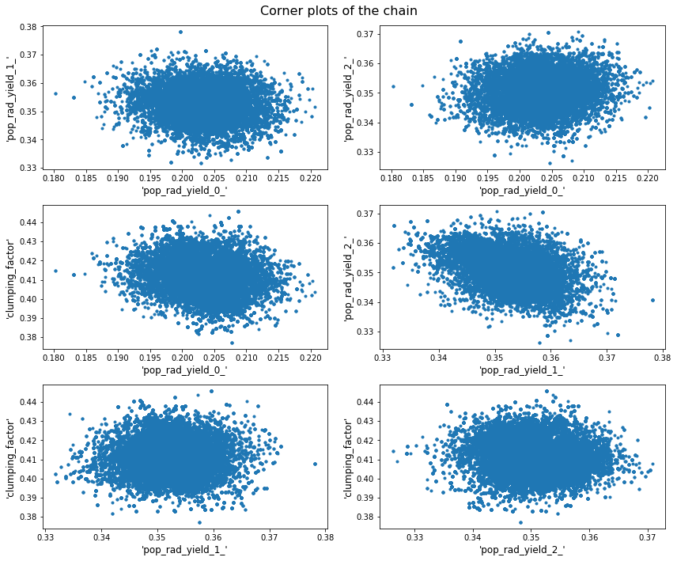
Corner Plots

Slide 15
Levenberg - Marquardt

Slide 16
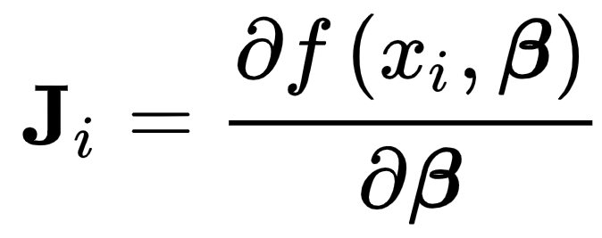
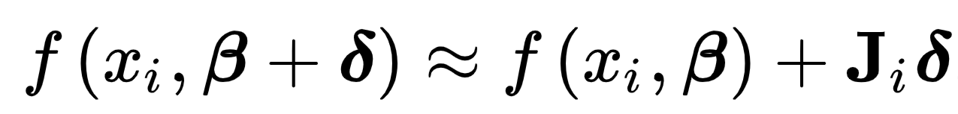
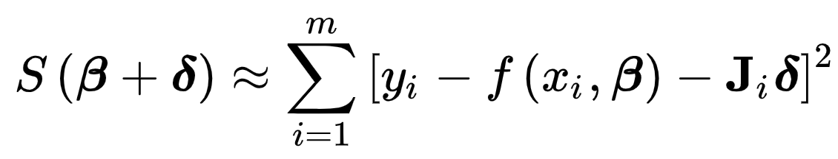
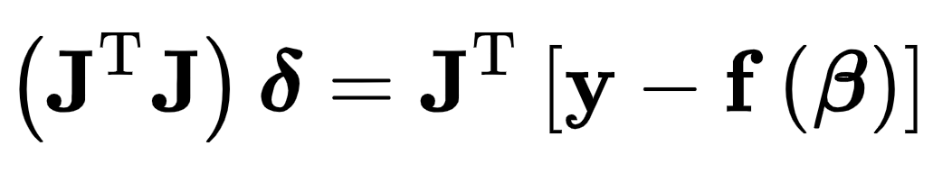
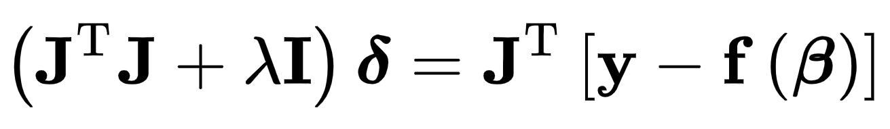
How does it work?
Notes:
Update the lambda on each iteration
Start with zero
If it gets worse (bigger chi-square): multiply the lambda with a factor
If it gets better (lower chi-square): divide the lambda with a factor

Slide 17
Why is it important to us?
Will give us a reasonable starting point
More critical: The covariance matrix
We will draw samples from this covariance matrix and feed these samples to the MCMC
In a hope that it converges in 10^3 to 10^4 steps

Slide 18
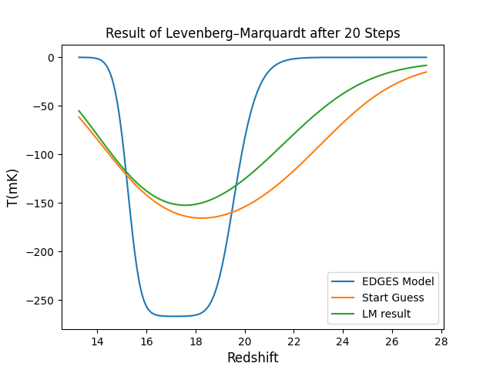
Best Result Up to now!
Runtime: ~15 minutes for 20 steps
Still a bit problematic
Boundary limitations shall be imposed to stop ARES from crashing!
This matter is much easier to achieve when dealing with MCMC

Slide 19
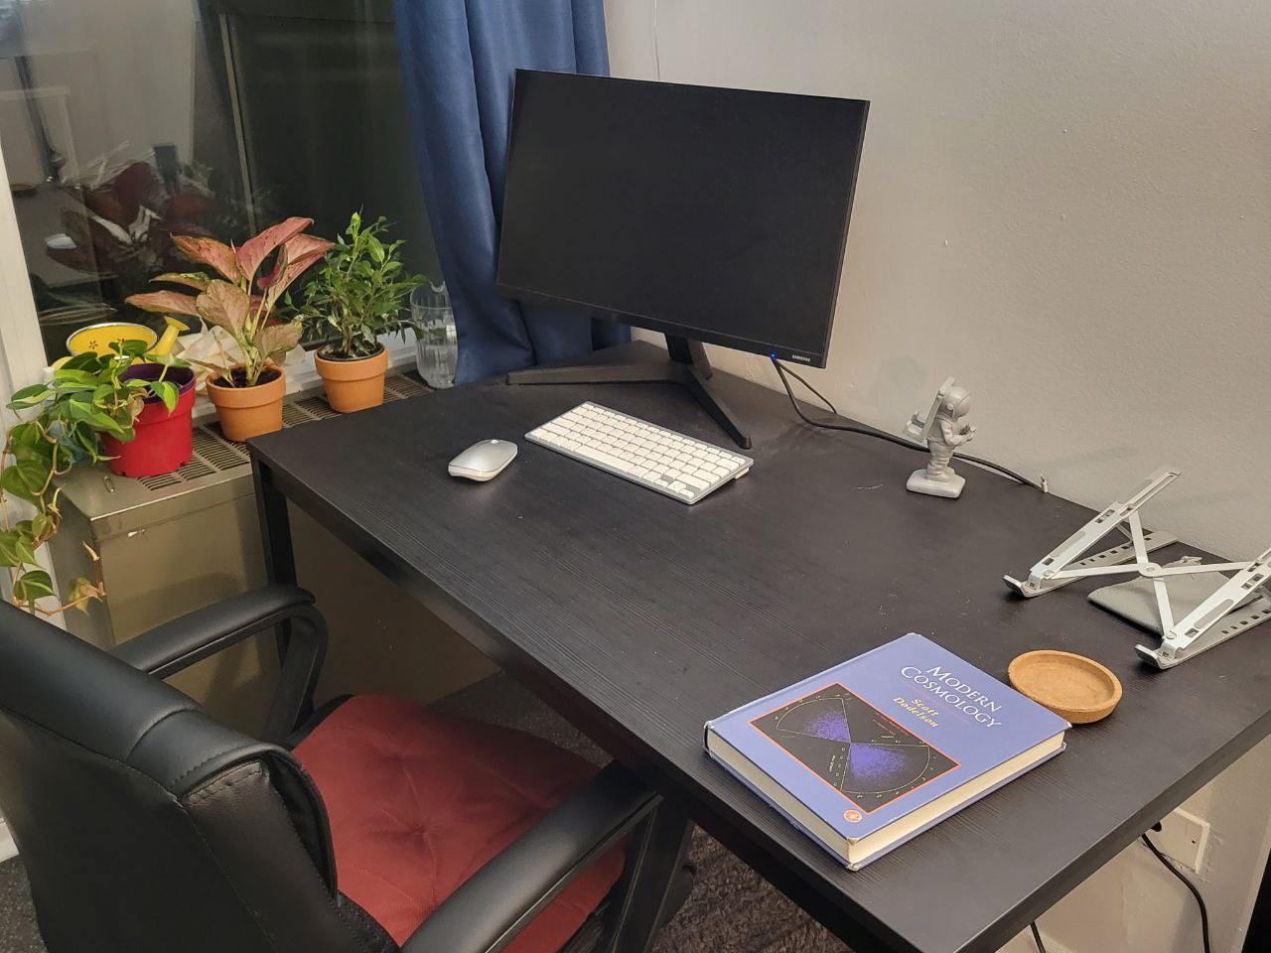


Do I have a photo of where I work?!

Slide 20
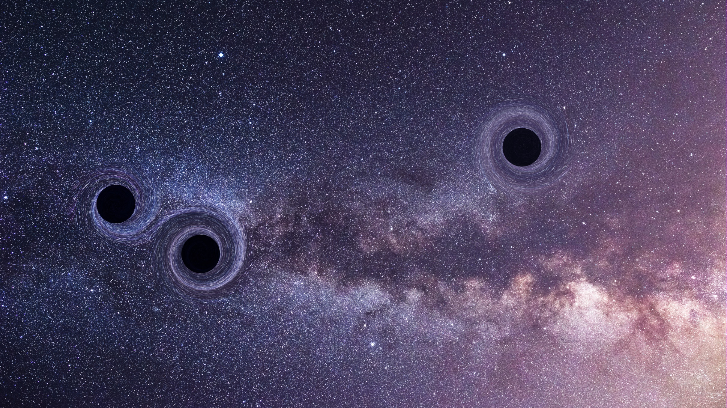
Thank You for Your Attention

